Slide 1
Lec 2
Applied Physics

Slide 2
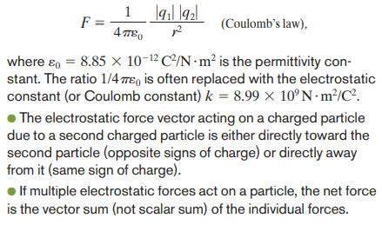
Coulomb’s Law

Slide 3
Principle of superposition
q₂
q₁
q₄
q_{n}
q₃
q₅

Slide 4
Shell theory

Slide 6
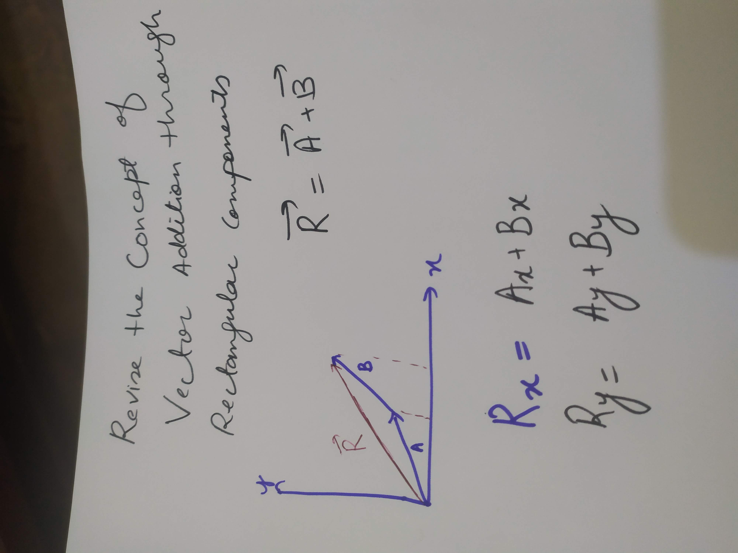
Examples to find Electric force using coulomb’s law

Slide 7
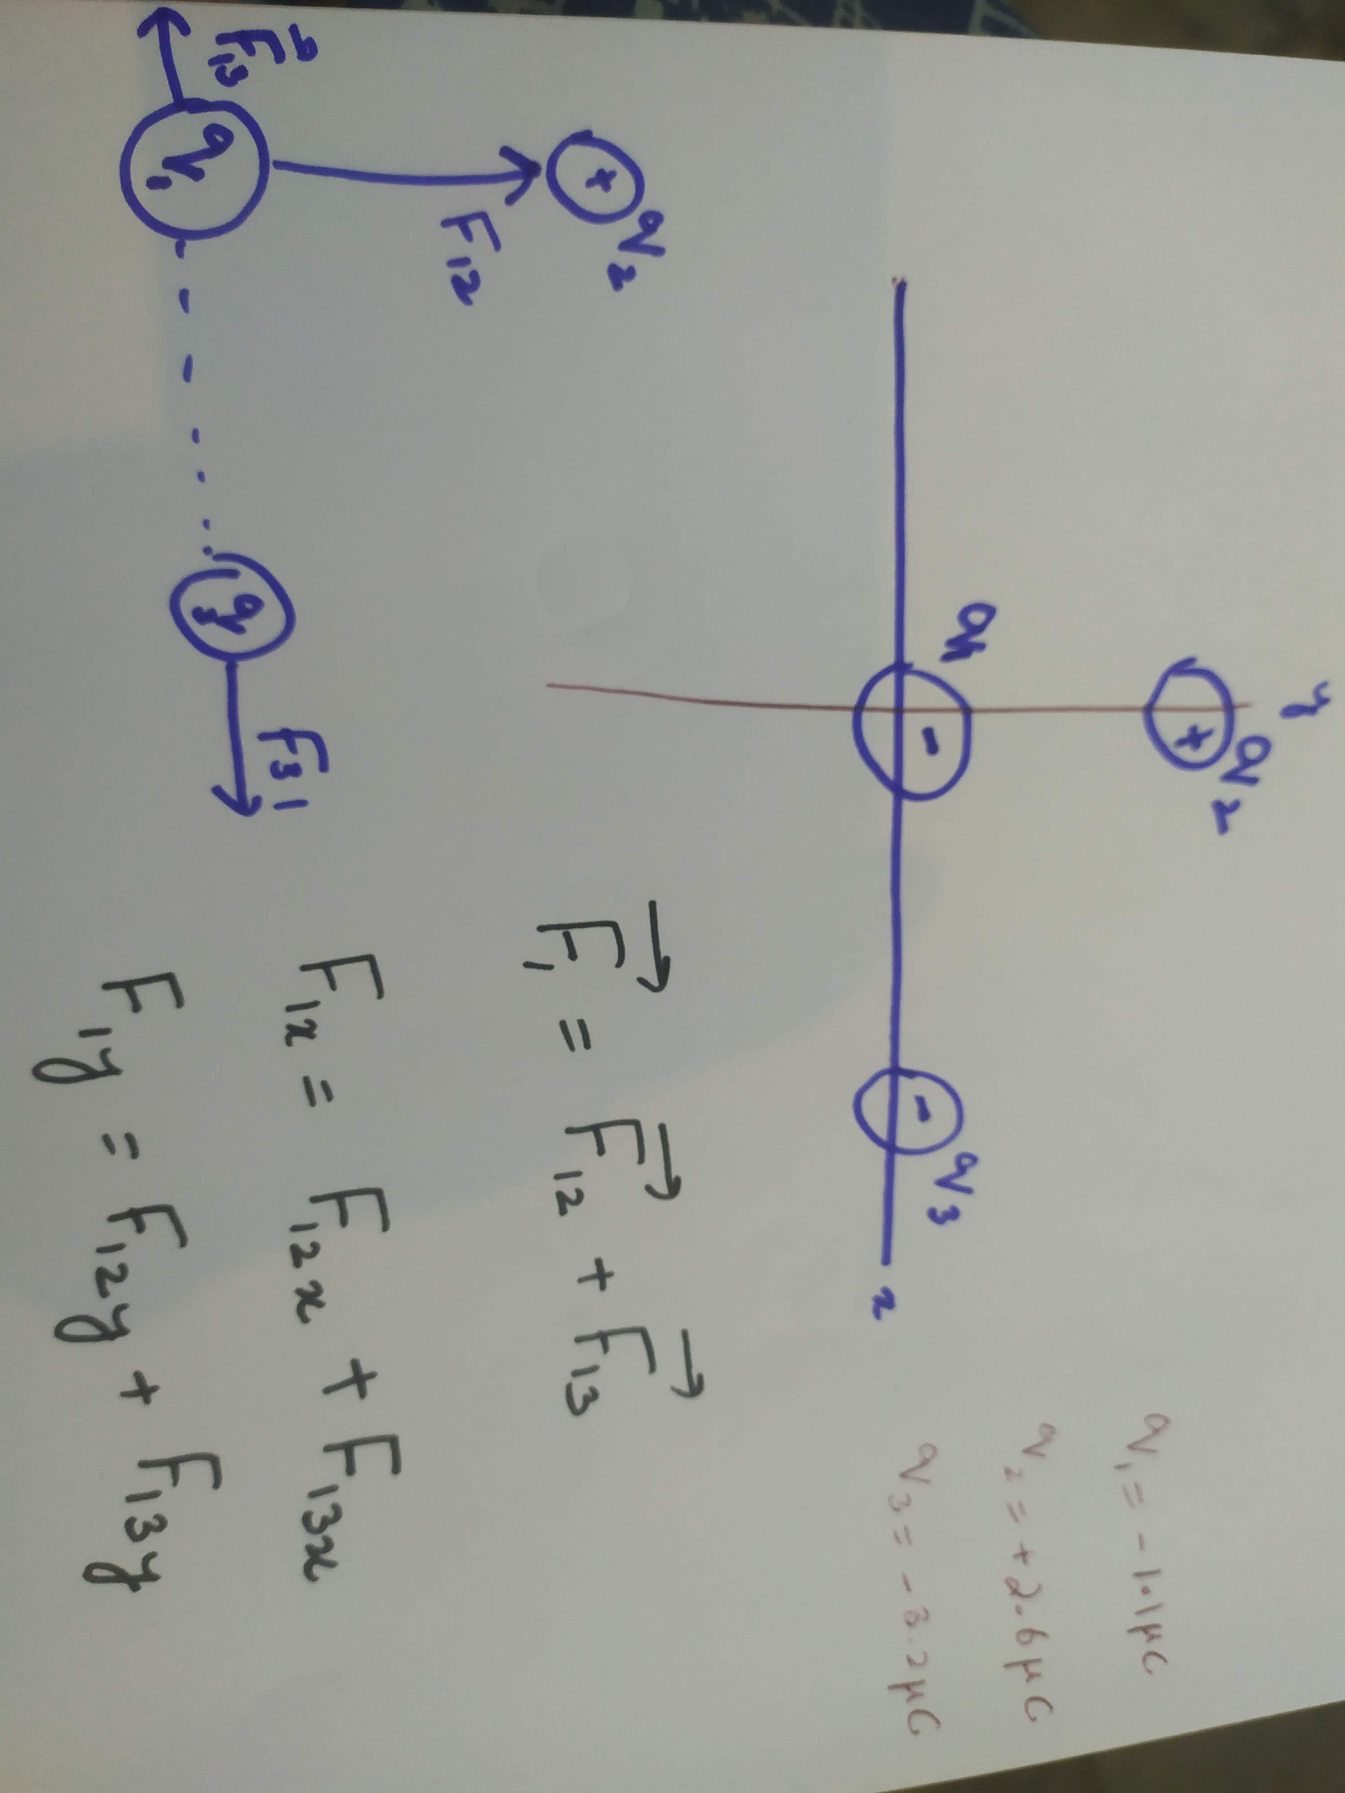

Slide 8
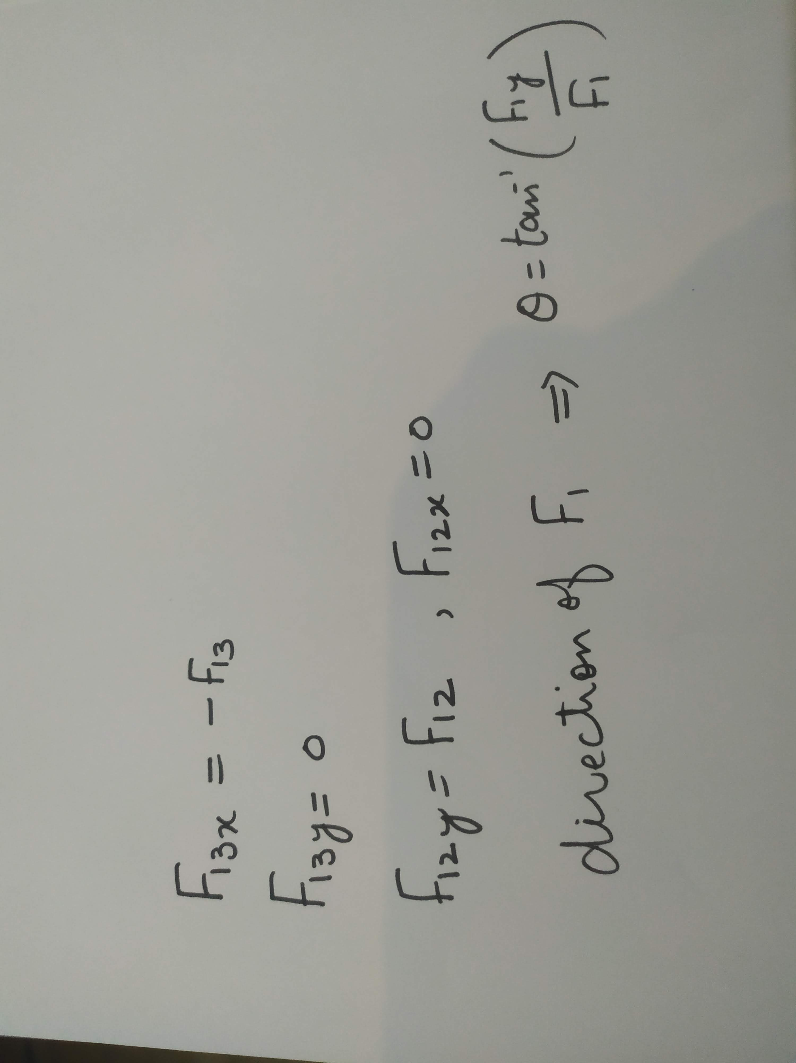

Slide 9
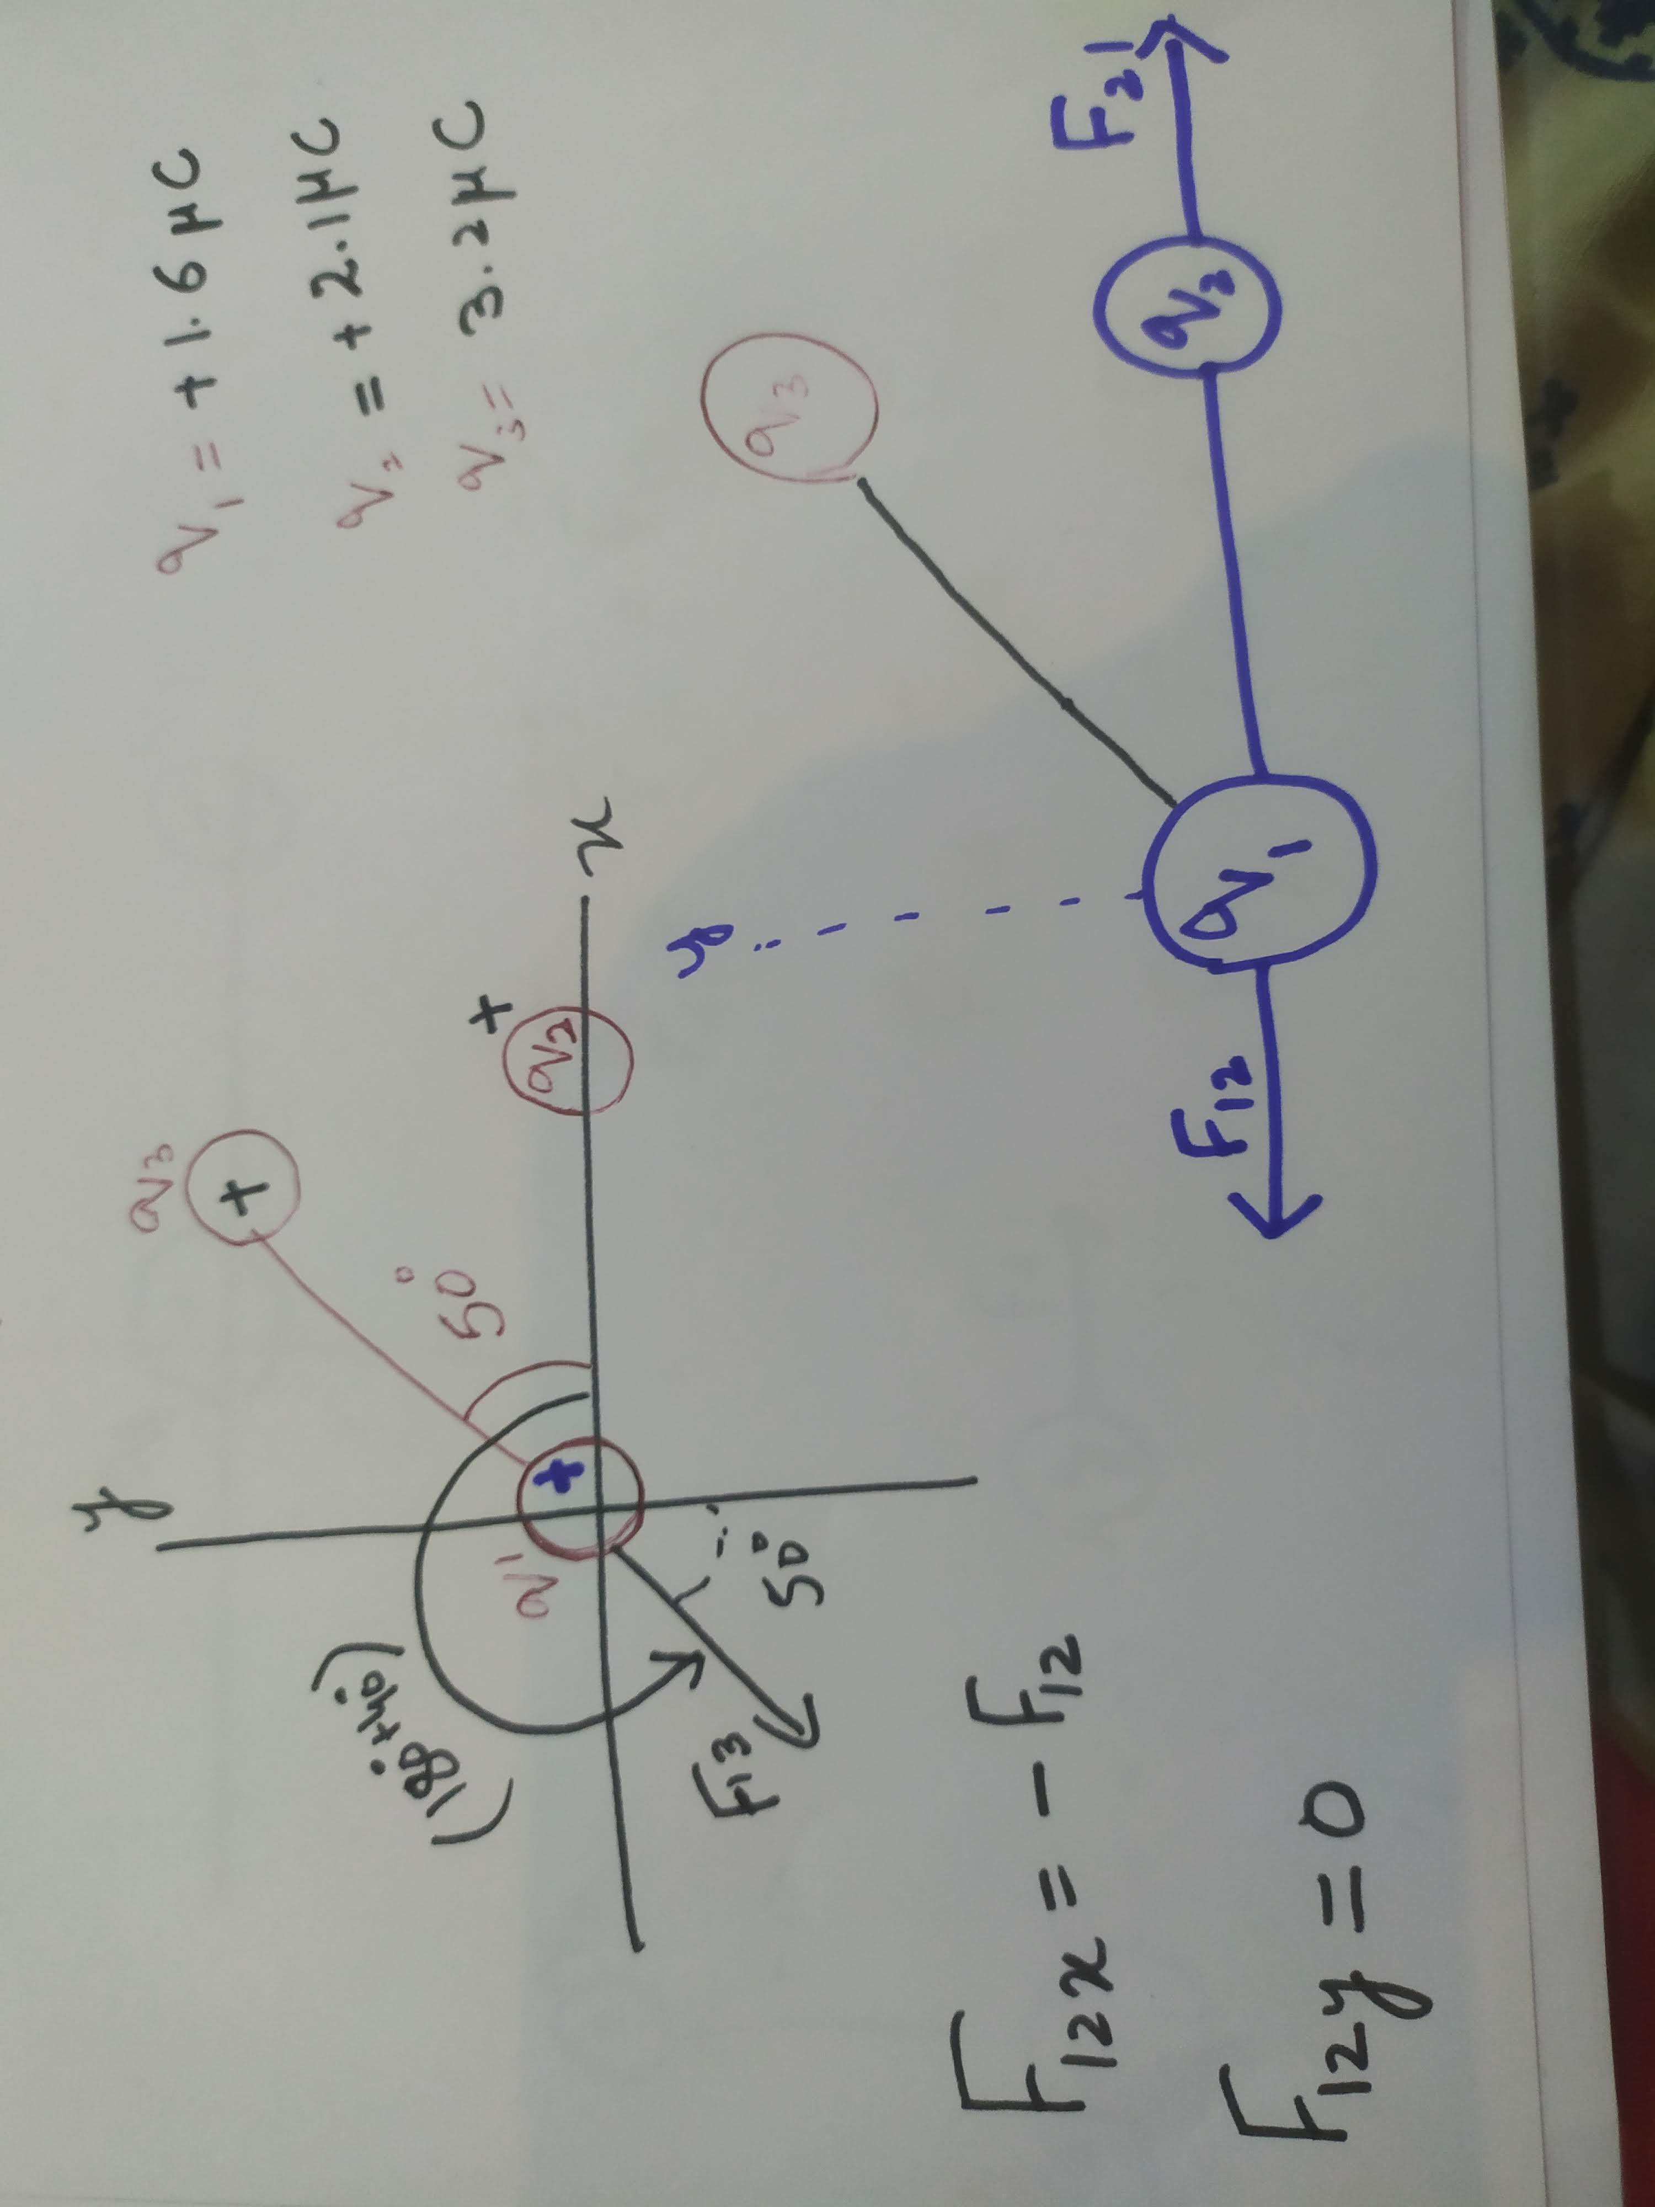
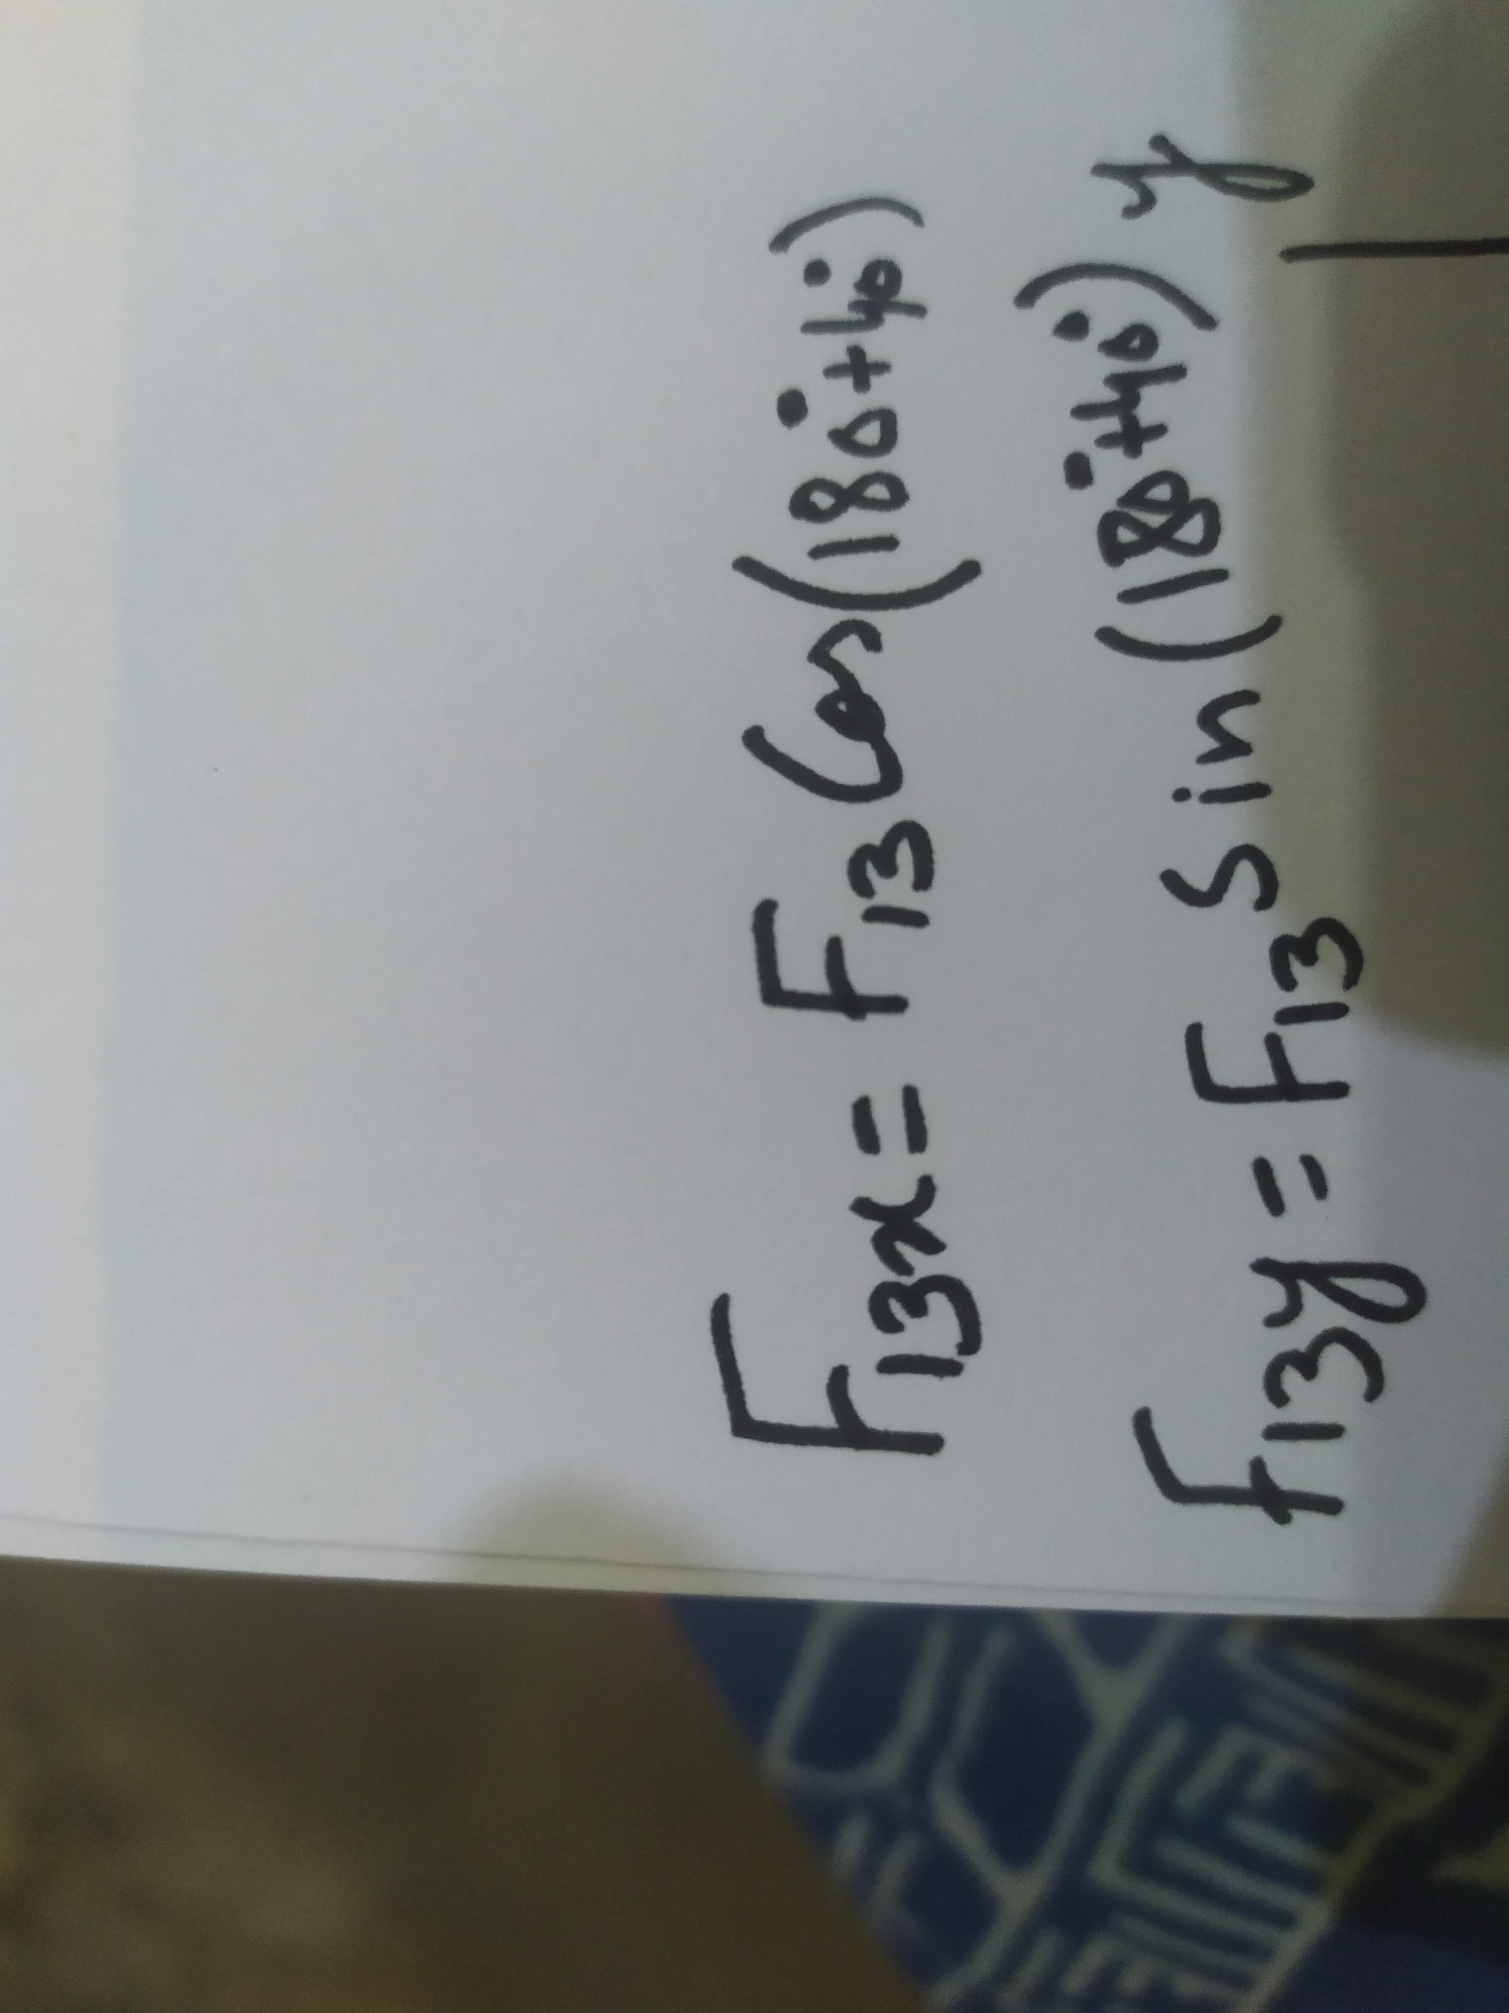
practice

Slide 10
Three charges lie along a straight line and are separated by a distance d . charges 1 and 2 are fixed, charge 3 is free to move it becomes in equilibrium if placed at distance d. find the magnitude of charge 1 in terms of 2. sum of all the forces acting on charges 3=0 force on 3 by charge 2=-( force on charge 3 by charge 1) columbs law
2
3
d
d
1

Slide 11

$F_{31}$= k $q_{3}q_{1}$/${(2d)}^{2}$
$F_{32}$= k$q_{3}q_{2}$/$d^{2}$
$F_{31}$=-$F_{32}$
$q_{1}=−4q_{2}$

